Slide 1
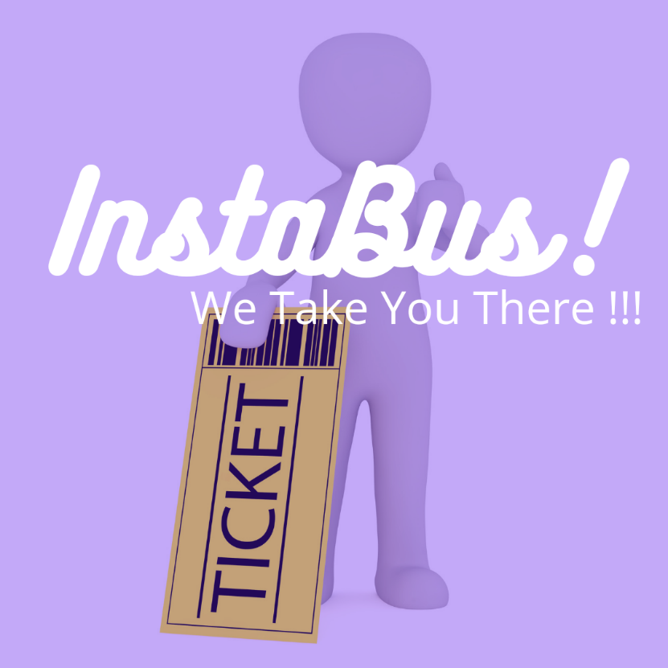
ONLINE BUS BOOKING SYSTEM Presented By – Vishakha Satpute Pratiksha Varawate

Slide 2
INDEX
Introduction
Scope
Modules
Technologies
Flow Diagrams
Angular & Its Architecture
Spring Boot & Its Architecture
Application Interfaces
Advantages
Features
Conclusion

Slide 3
INTRODUCTION
The bus booking system is a Java Spring Boot, MySQL and Angular Project which runs on the tomcat server, you can also run this project eclipse and Spring Tool Suites. We have developed this java Spring Boot and Angular project on Bus Booking System to automate the Bus Booking System process. The main features of this project are to manage Bus, Ticket Booking, Sales, Operations, Customers and Booking.
The Online Bus Booking System is a web-based application that allows visitors to check ticket availability, buy a bus ticket and pay for the bus ticket online.

Slide 4
SCOPE
The scope of the online bus booking system is: A person should be able to:
Login to the system through the first page of the application.
Otherwise we can register into the system.
Should be able to create a new login for accessing the reservation facility.
Able to choose the seats which are available for a certain class.

Slide 5
MODULES OF BUS BOOKING SYSTEM
Bus module: We can manage all the operations related to Buses from this module.
Ticket Booking module: This module is normally developed for managing the Ticket Booking operations.
Operations module: This module manages Operations functionalities.
Admin module: Admin modules perform all the create, read, update and delete operations of bus application facilities.
Booking module: It manages all the functionalities of Booking.
Customer module: Register, login, booking.

Slide 6
Technologies used in this project:-
Frontend:
VisualStudio Code IDE
Angular 13+
Node js & Npm
TypeScript
Angular CLI
Bootstrap
Backend:
Spring Boot
Maven
Spring Data JPA
JDK 1.8
Embedded Tomcat server
MySQL Database

Slide 7
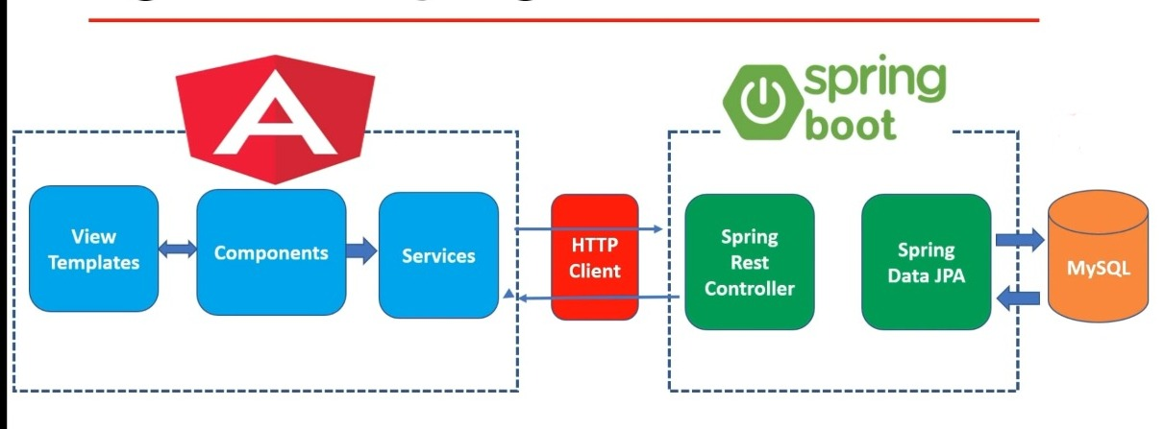
Web Application Block Diagram

Slide 8
ANGULAR:
Angular is a platform and framework for building single-page client applications using HTML and TypeScript. Angular is written in TypeScript.
Great for Single page applications.
Angular is modular.
Built-in features DI, data binding etc.

Slide 9
ANGULAR APPLICATION ARCHITECTURE
The architecture of an angular application relies on certain fundamental concepts. The basic building blocks of the angular framework are angular components that are organized into Ng modules. Ng modules collect related code into functional sets; an angular application is defined by a set of Ng modules. An application always has at least a root module that enables bootstrapping and typically has many more feature modules.
Modules, components and services are classes that use decorators. These decorators mark their type and provide how to use them.
An application’s components typically define many views, arranged hierarchically. Angular provides the Router service to help you define navigation paths among views. The router provides sophisticated in-browser navigational capabilities.

Slide 10
SPRING BOOT:
Spring boot to develop REST web services.
Spring Boot has taken the Spring framework to the next level. It has drastically reduced the configuration and setup time required for spring projects.

Slide 11
SPRING BOOT APPLICATION ARCHITECTURE
The Spring Boot is built on top of the core spring framework. It is a simplified and automated version of the spring framework. The spring boot follows a layered architecture in which each layer communicates with other Layers. The spring boot documentation provides the following definition of the spring boot framework.
“Spring Boot makes it easy to create stand-alone, production-grade Spring-based application that you can just run”
The main aim of spring boot is to remove the XML and annotation-based configurations. This spring provides the following benefits such as opinionated, convention over configuration, stand-alone, and production-ready.

Slide 12
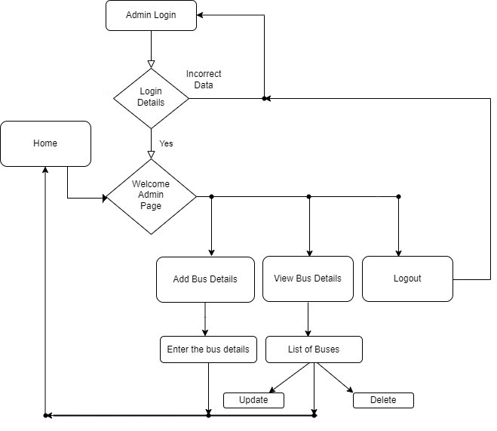
Work Flow Diagram

Slide 13
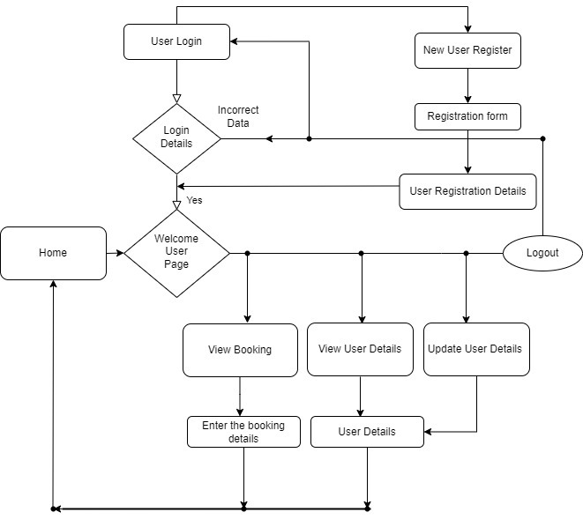
Work Flow Diagram

Slide 14
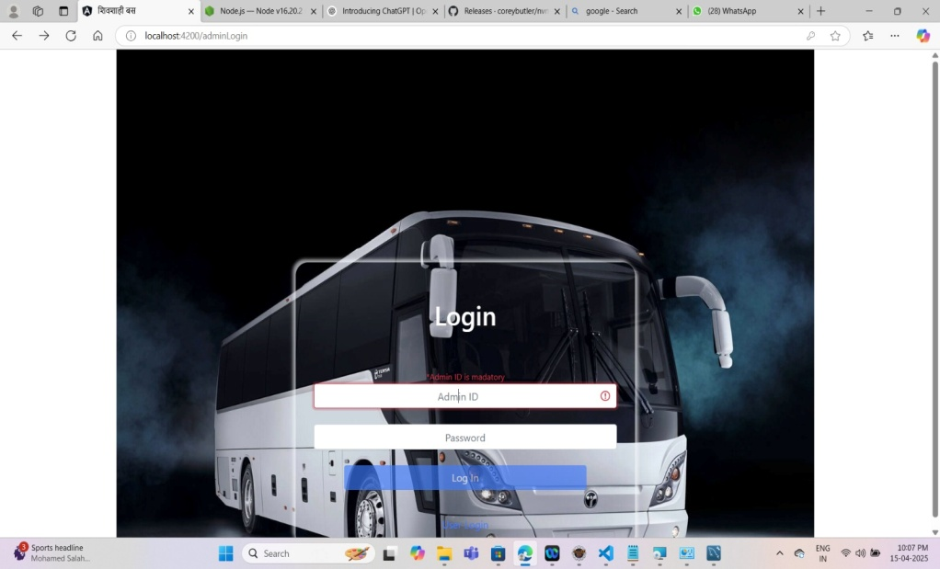
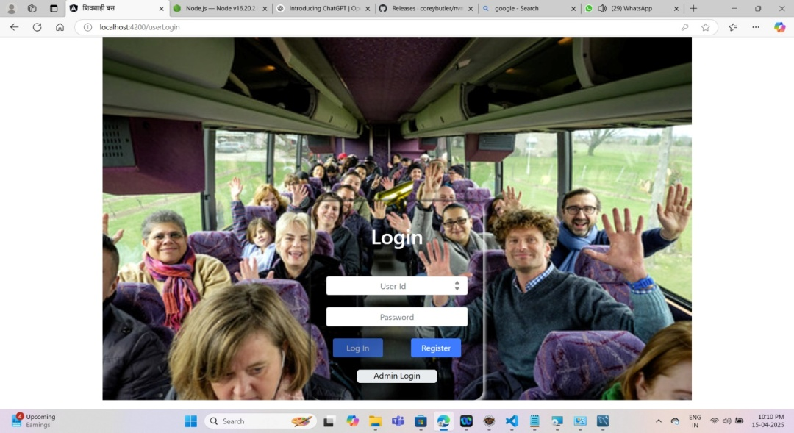
Screenshots
User Login
Admin Login

Slide 15
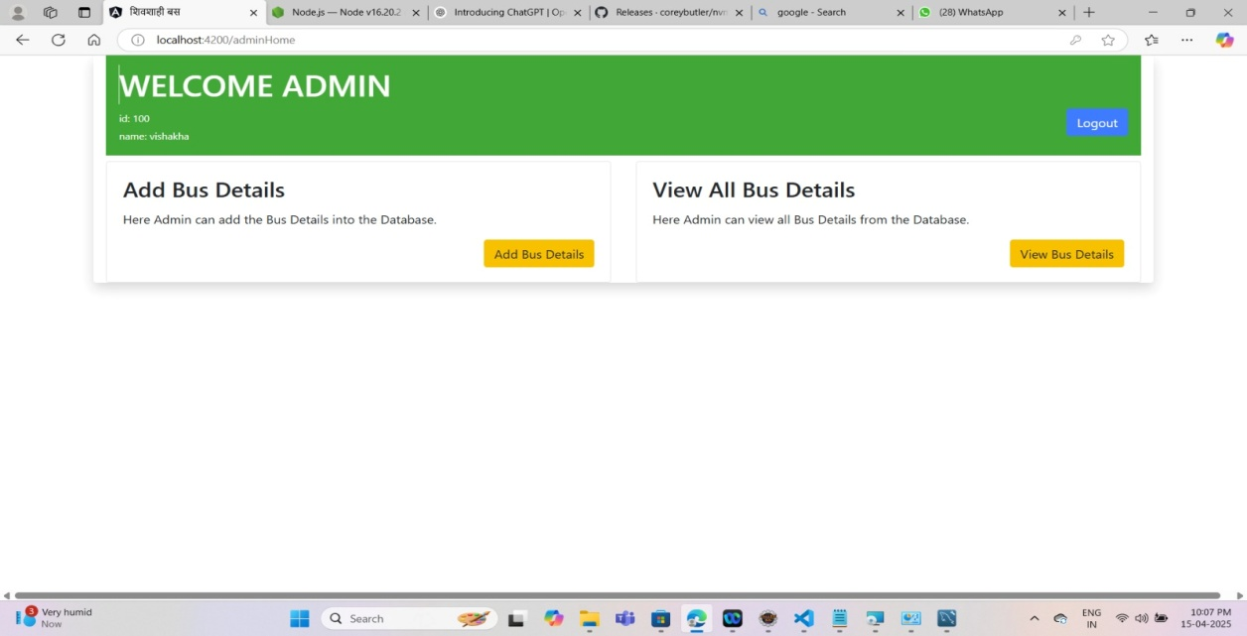
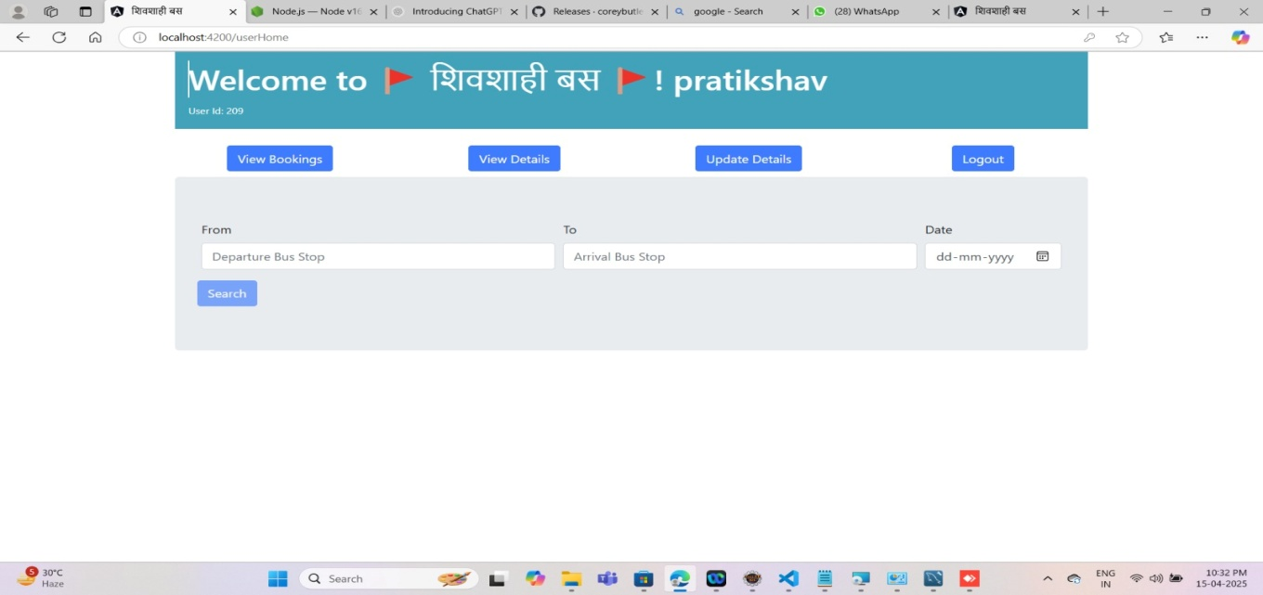

Slide 16
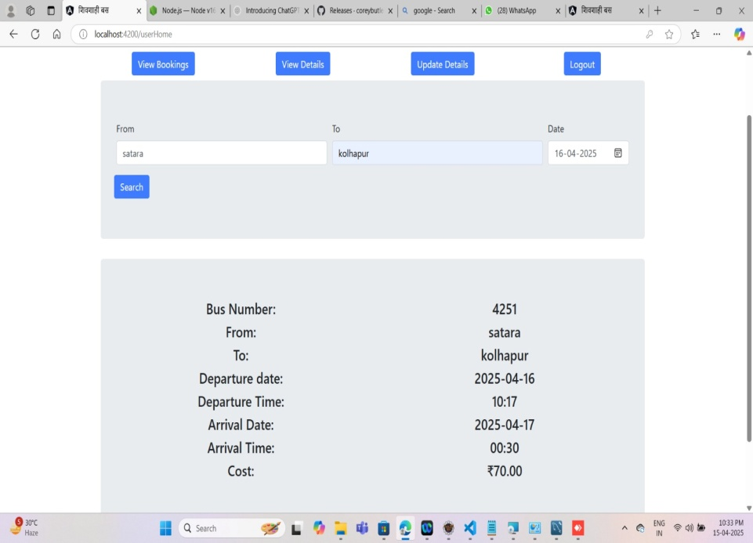
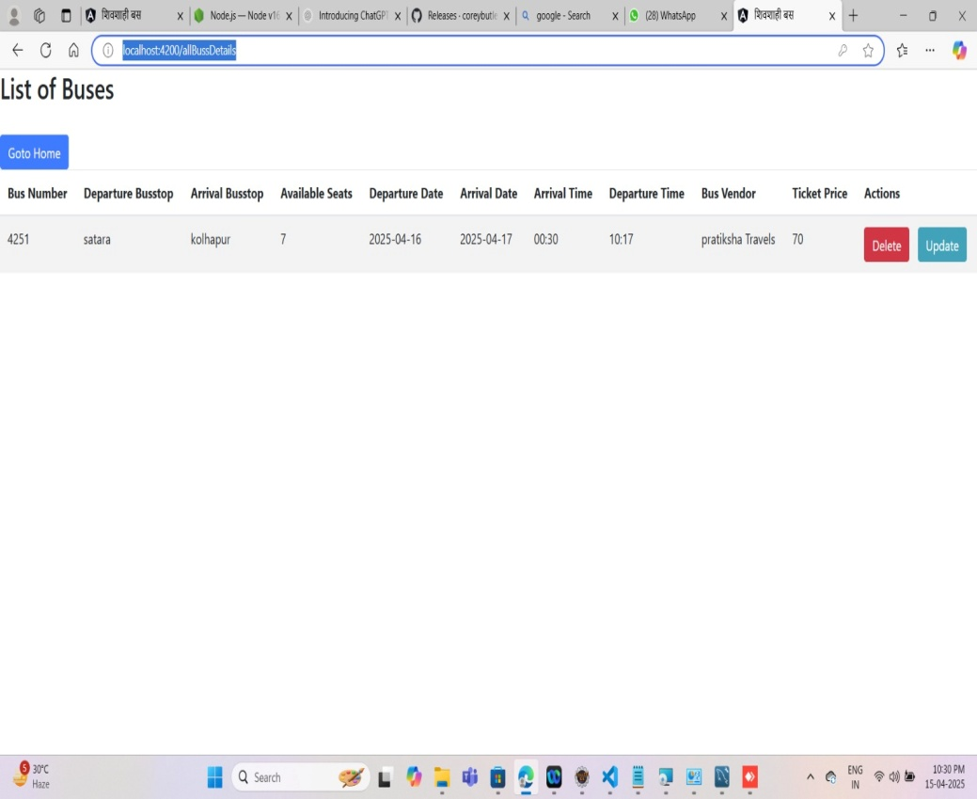
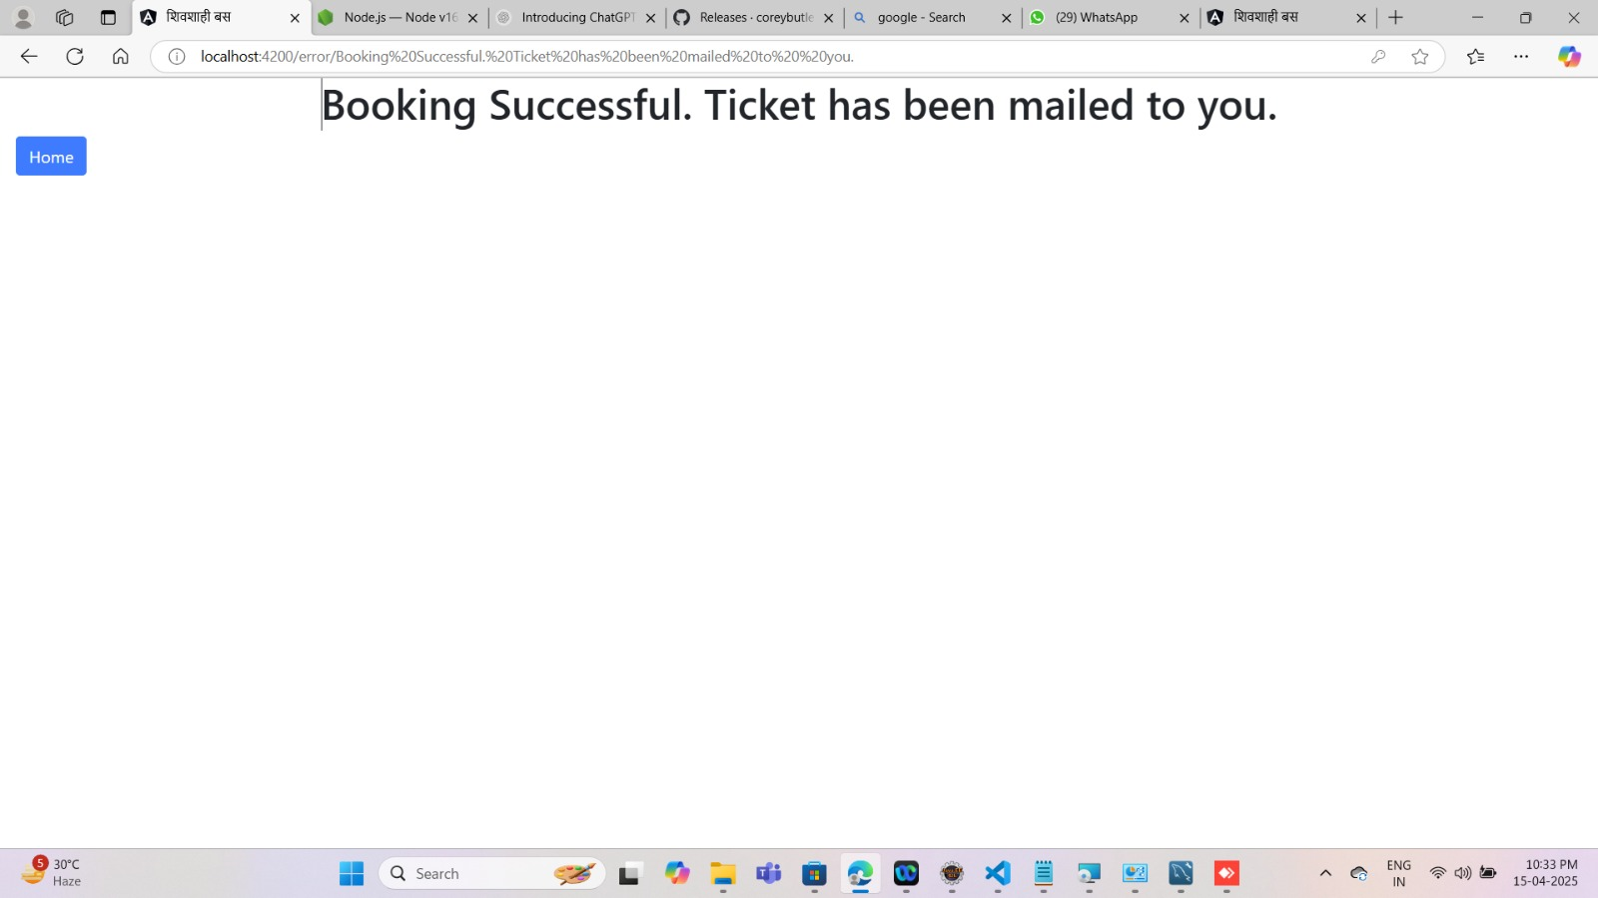

Slide 17
ADVANTAGES
Good customer service
Commission Free
Open 24/7 for reservation
Discount codes
Clear and simple process
Seat of your own choice

Slide 18
FEATURES
It simplifies the tasks and reduces the paper work.
Accuracy.
Availability.
User Friendly.
Efficiency.
Reliable.

Slide 19
CONCLUSION
The online ticket booking system is an application where the customer can book a ticket online and 24/7 hours a day from any place in the world. Customers can also interact with the ticket booking website to know any other details they want. The online ticket booking system has developed successfully. System performance was also found to be satisfactory. This is a user-friendly application. Through this application, the cost can be reduced and efficiency is increased. With help of this application, customers can book tickets, and can know the status of the bus.

Slide 20

Thank You !!!

